Slide 1
Positive
Classroom
Behavioral
Supports
Supporting &
Responding to Behavior
Evidence-based Strategies for Classroom Teachers
Summer Academy
Day 3
www.pbiscaltac.org
Notes:
To change the image on this slide, select the picture and delete it. Then click the Pictures icon in the placeholder to insert your own image.

Slide 2
AGENDA
Morning Routines
Individualizing PCBS
Mental Health Instructional & Classroom Considerations
Routine-based Support Guide
Keeping It Simple BSP
Data Systems
Classroom Planning
Positive
Classroom
Behavioral
Supports
www.pbiscaltac.org
Notes:
To change the image on this slide, select the picture and delete it. Then click the Pictures icon in the placeholder to insert your own image.

Slide 3
PCBS Day 3 EXPECTATIONS
Routines Expectations | Table Conversations | Group Work | Jigsaw Activity
Being a Team Player | Asking questions | Sharing the work | Reading assigned part
Being Amazing | Contributing ideas | Monitoring the time to complete the task | Sharing the most valuable points
Being Respectful | Pausing & Paraphrasing | Active Listening | Presuming positive intentions

Slide 4
Current Mood

Slide 5
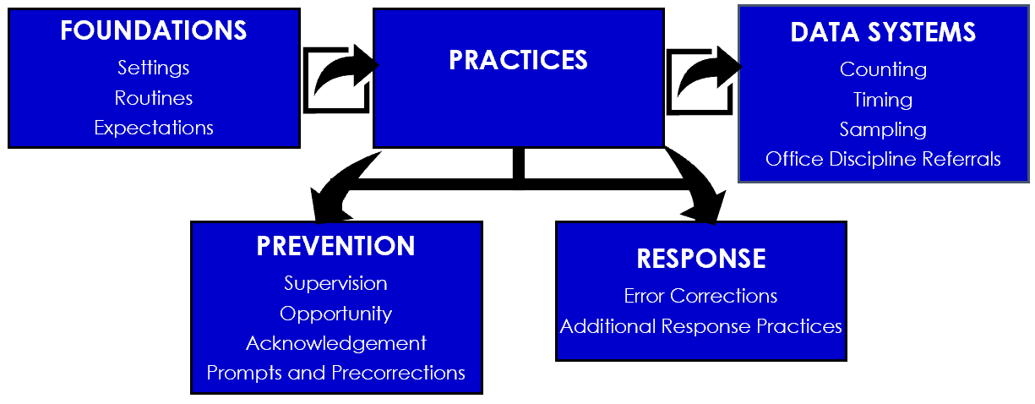
Positive Classroom
Behavior Supports (PCBS)

Slide 6
Positive Classroom Behavior Supports is like…
because…

Slide 7
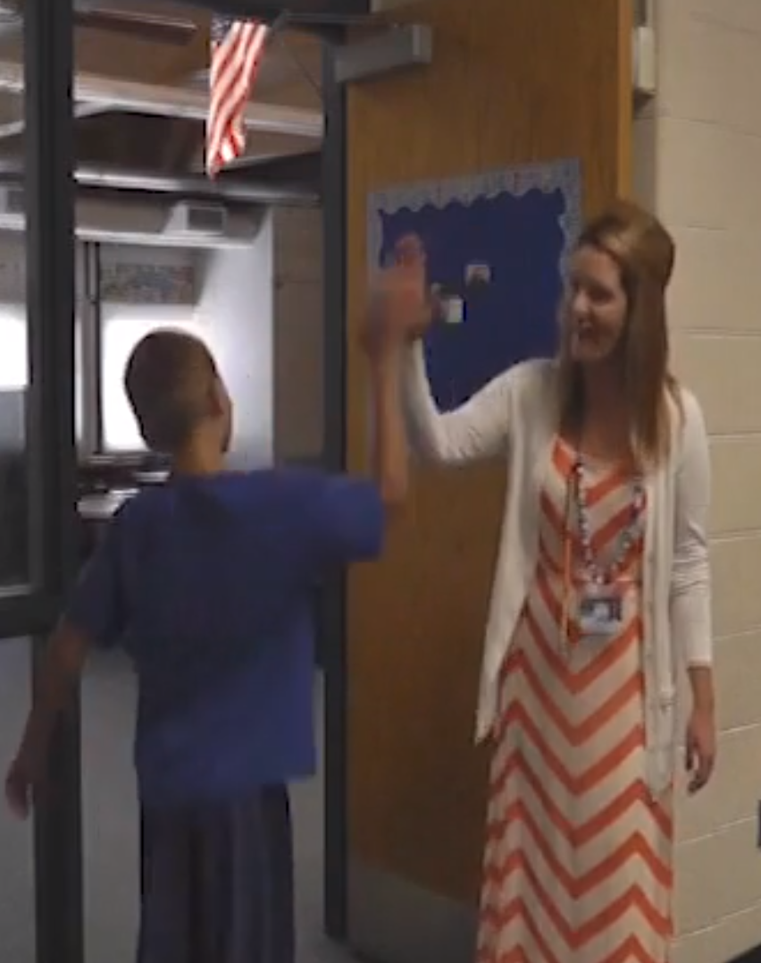
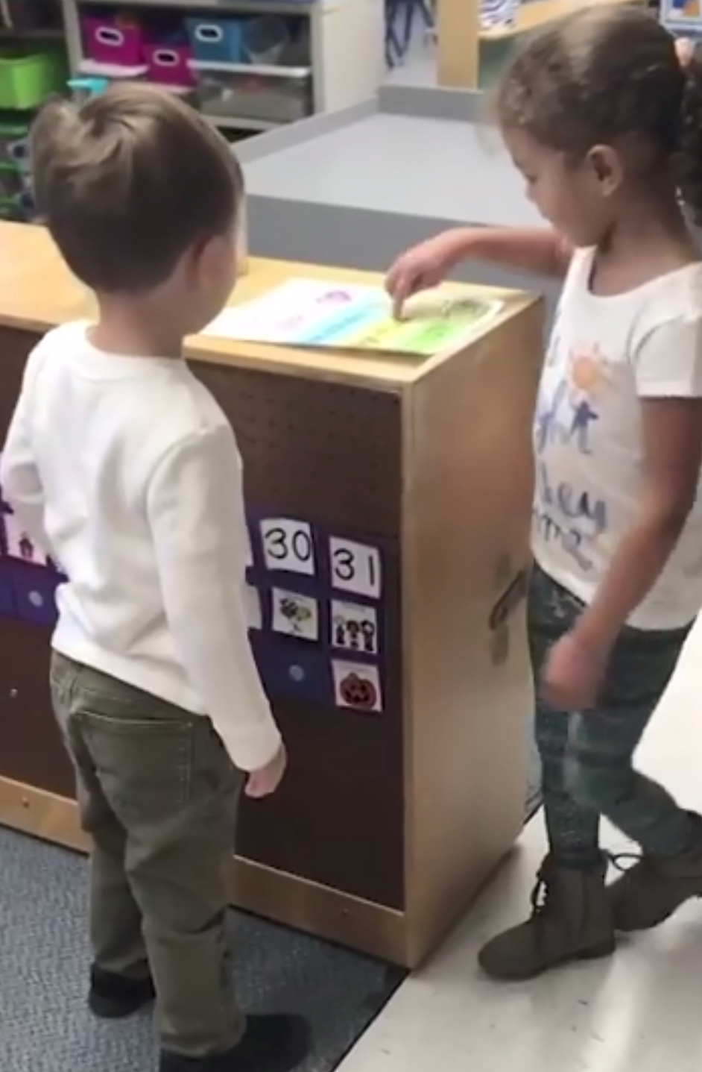
MORNING ROUTINES
https://www.dropbox.com/s/ly1ilgc0jm9wlmd/morning%20routines%207415%20%282016_12_03%2020_01_07%20UTC%29.mov?dl=0

Slide 8
Welcoming Students with a Smile
ADDRESSING UNDERLYING CAUSES OF MISBEHAVIOR
BENEFITS FOR TEACHERS
JIGSAW
BUILDING
COMMUNITY

Slide 9
The Hidden Power
of the Smile
https://www.ted.com/talks/ron_gutman_the_hidden_power_of_smiling?language=en

Slide 10
Please be back
at

Slide 11
Behavioral Science
ANTECEDENTS “Prevent” | BEHAVIOR “Teach” | CONSEQUENCE “Reinforce” “Respond”
Design supportive environments using antecedent strategies promoting a positive and safe school climate. | Teach positive expectations, self-management and social appropriate peer interactions supporting a positive and safe school climate for ALL students. | Provide specific performance feedback and a continuum of positive reinforcement intrinsically motivating ALL students to engage in socially appropriate behaviors.

Slide 12
Mental Health Disorders
Instructional Strategies & Classroom Considerations
Prevent | Teach | Reinforce/ Respond
Notes:
Barb: show toolkit and strategies

Slide 13
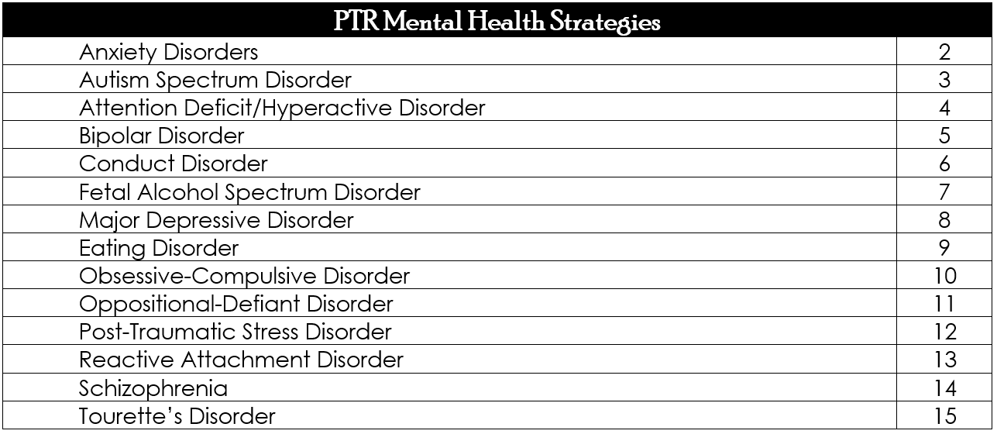
Mental Health Disorders
Instructional Strategies & Classroom Considerations
Notes:
Barb: show toolkit and strategies

Slide 14
what

Slide 15
Please be
back at

Slide 16
Section I: D.A.S.H Section II: Classroom Routine Menus Section III: Progress Report

Slide 17
Section I:
D.A.S.H.
Define behavior
Ask questions
See the Behavior
Hypothesis

Slide 18
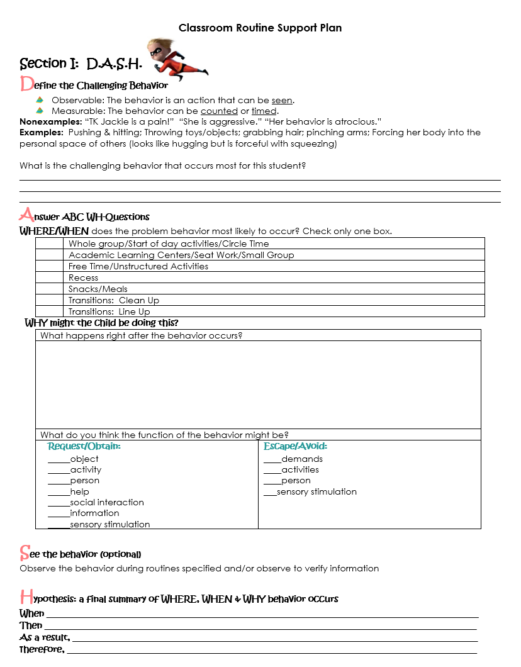

Slide 19
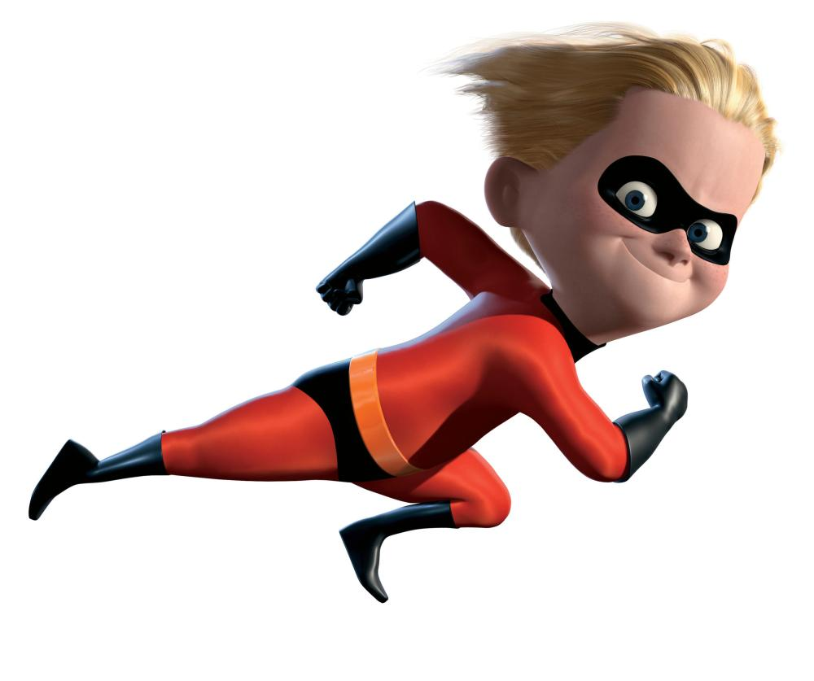
Defined so clearly that a person unfamiliar with the student could recognize the behavior without any doubts!
Define the Challenging Behavior
Observable: The behavior is an action that can be seen.
Measurable: The behavior can be counted or timed.

Slide 20
 | Whole group/Start of day activities/Circle Time
 | Academic Learning Centers/Seat Work/Small Group
 | Free Time/Unstructured Activities
 | Recess
 | Snacks/Meals
 | Transitions: Clean Up
 | Transitions: Line Up
Answer
WH-questions
WHERE/WHEN
(the Routine)does the problem behavior most likely to occur?

Slide 21
What happens right after the behavior occurs?
What do you think the function of the behavior might be?
Request/Obtain: _____object _____activity _____person _____help _____social interaction _____information _____sensory stimulation | Escape/Avoid: ____demands ____activities ____person ___sensory stimulation
Answer
WH-questions
WHY might the child be doing this?

Slide 22
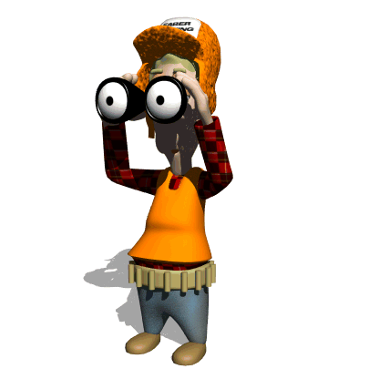
See the behavior
observe the behavior during routines specified
observe to verify summary

Slide 23
When...
Then...
As a result…
Therefore…
Hypothesize a final summary of where, when & why behaviors occur

Slide 24
What is the challenging behavior that occurs most for TK Jackie?
Where/When does the
problem behavior
most likely to occur?
Why might TK Jackie
be doing this?

Slide 25
When TK Jackie transitions during morning centers,
then she will demonstrate aggression (pushes, hits and forces body into the personal space of peers),
as a result she is sent to a quiet space,
therefore she escapes from peers and/or activity

Slide 26
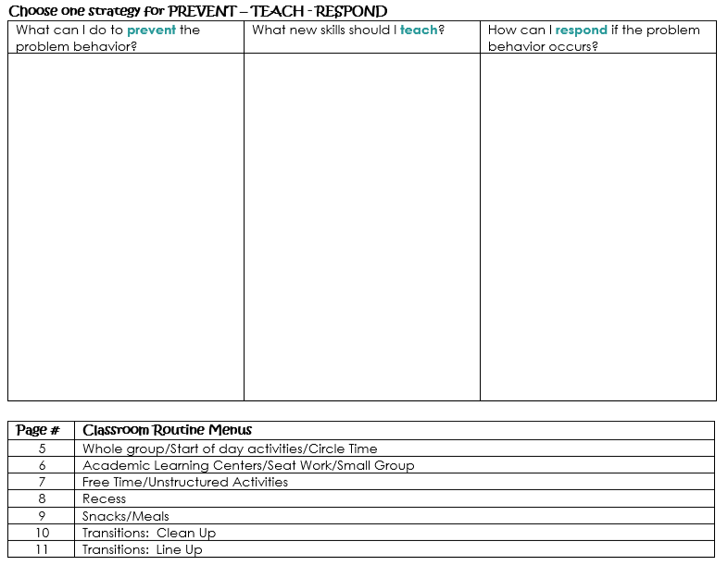
Section II: Classroom Routine Menus

Slide 27
Routine: TRANSITIONS (Line Up)

Slide 28
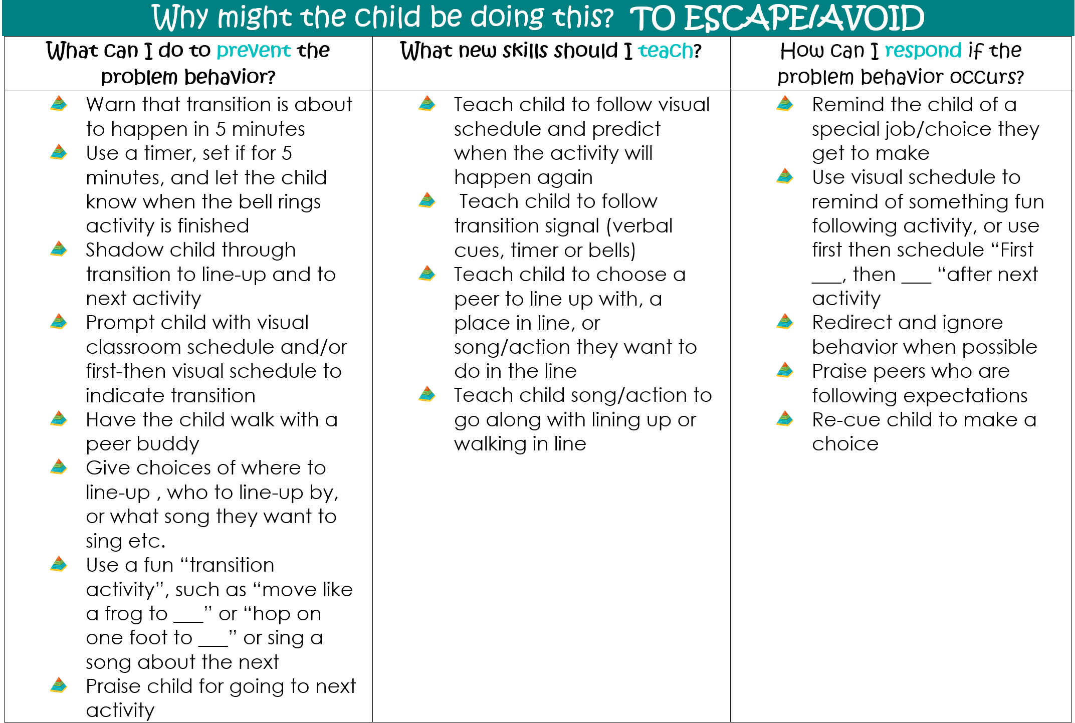
Routine: TRANSITIONS (Line Up)

Slide 29
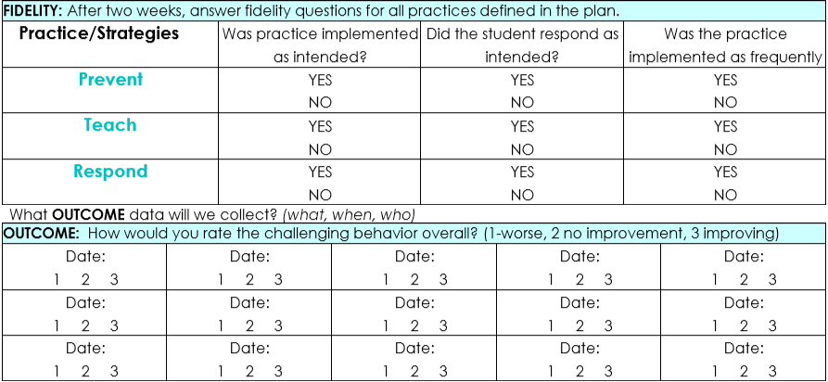
Section III: Progress Report

Slide 30
Behavior Support
Planning

Slide 31
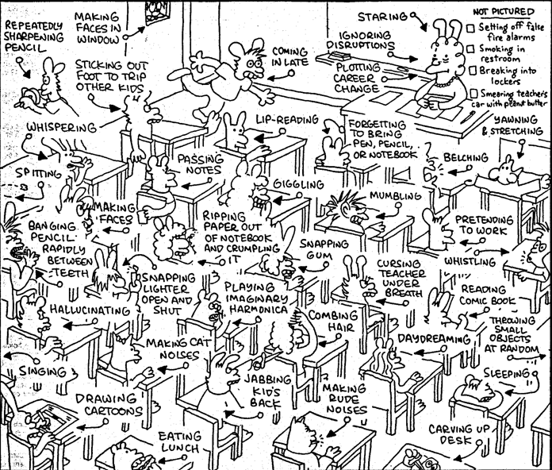
Difficulty taking turns
Refuses to share
Out of seat
Low level aggression
Difficulty following
directions
Frequent peer conflict
Disruptive
Talks out
Unprepared
Talks back to teacher
Uses inappropriate language
Tardy
Defiant
Refuses to do work
Positive Behavior Support Plan
For
LOW LEVEL Behaviors

Slide 32
STEP 1: TEACHER AND STUDENT INTERVIEW DATA
STEP 2: INTERVIEW DATA / PRECISE PROBLEM STATEMENT
STEP 3: FUNCTION Of BEHAVIOR STRATEGY PLANNING WORKSHEET
STEP 4: SUPPORT/SOLUTION PLAN
STEP 5: FIDELITY AND OUTCOME DATA
STEP 6: COACHING SUPPORT
Positive Behavior Support Plan
For
LOW LEVEL Behaviors

Slide 33
FISHBOWL
#1

Slide 34
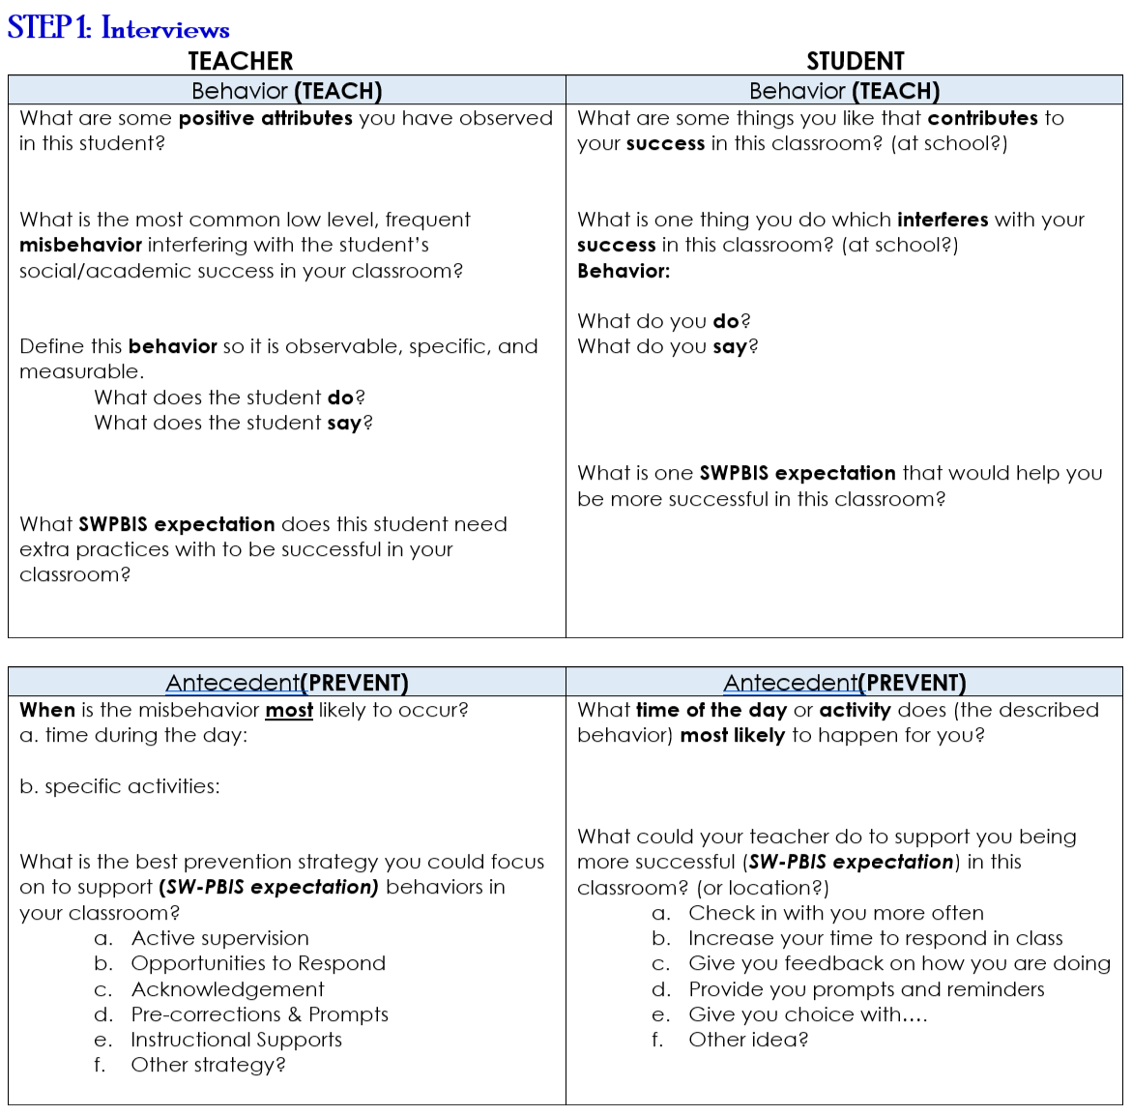
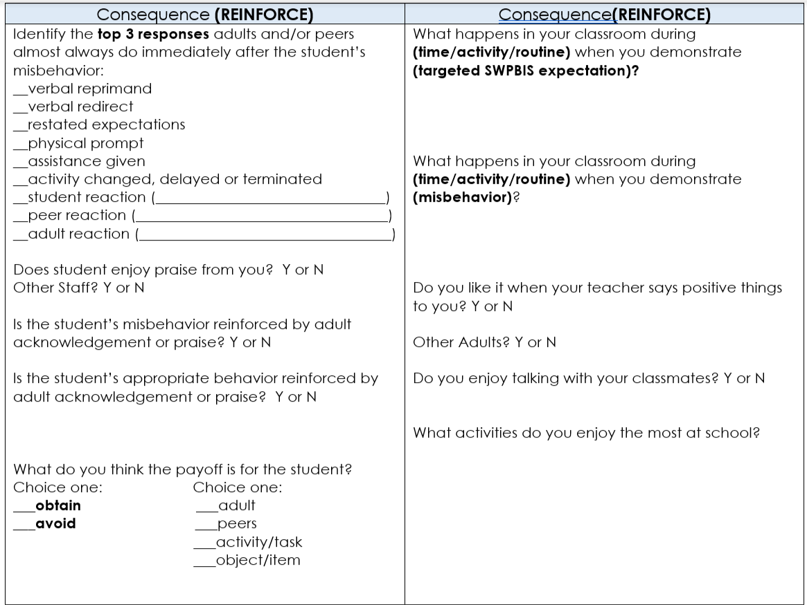

Slide 35
FISHBOWL
#1

Slide 36
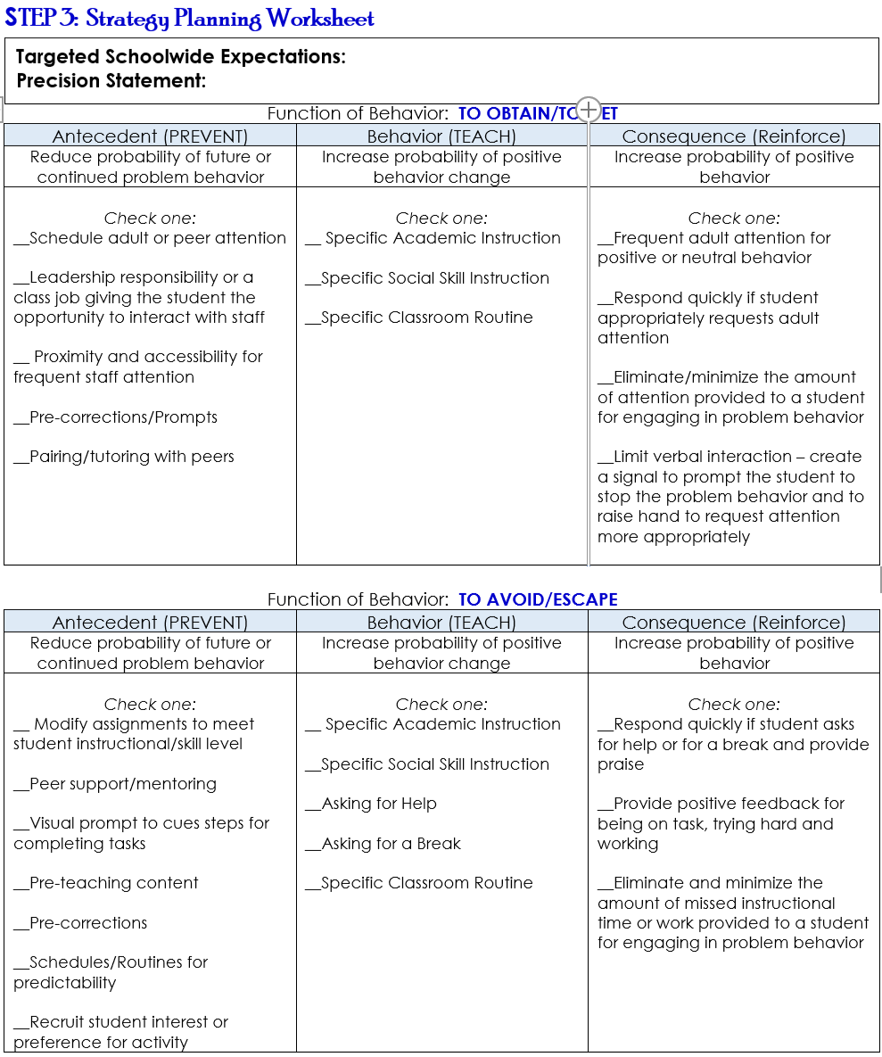
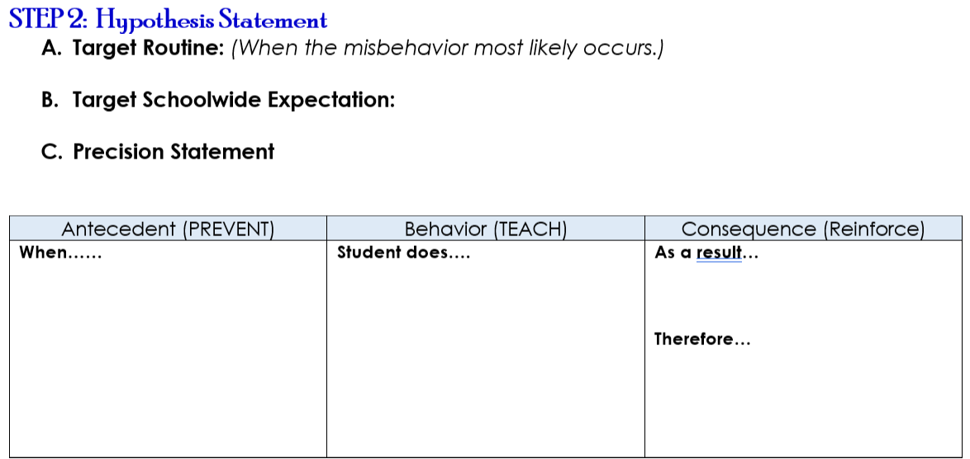

Slide 37
FISHBOWL
#1

Slide 38
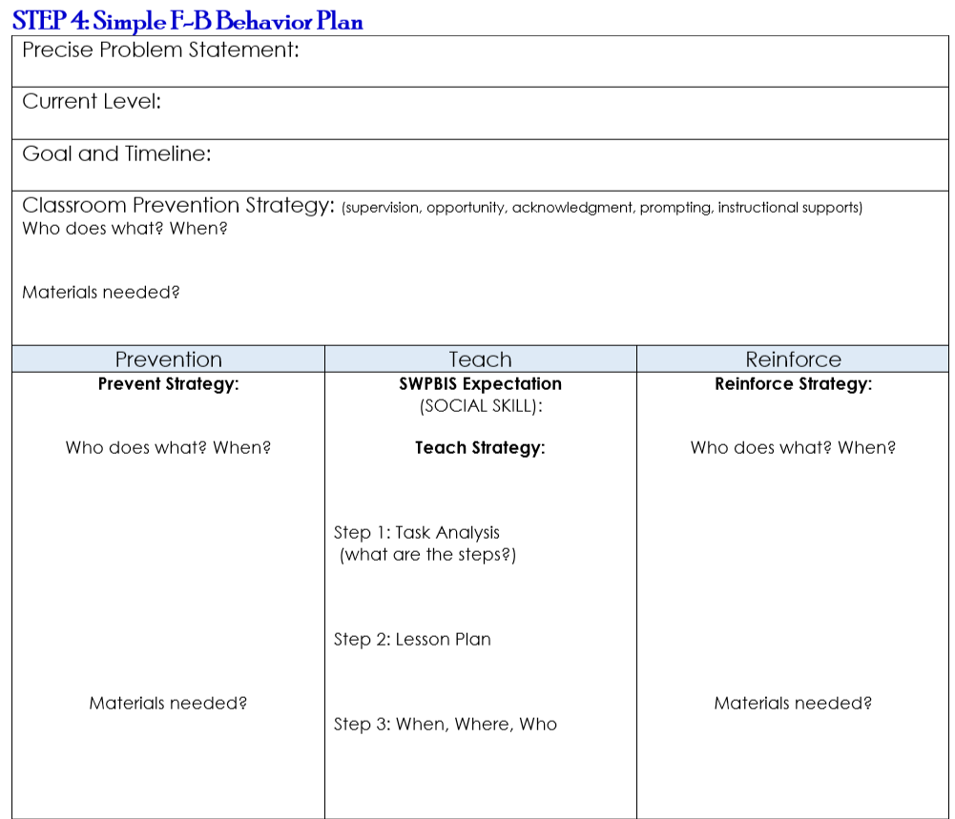

Slide 39
A + B = C Adult Behaviors equal student Change
Outcome
Fidelity
DATA
We made impact!
We got results!
We worked the plan the way it was designed.
We gave it our best effort!
Notes:
Remember that we always want to look at the fidelity of our systems and practices as well as the impact on student behavior or performance.

Slide 40
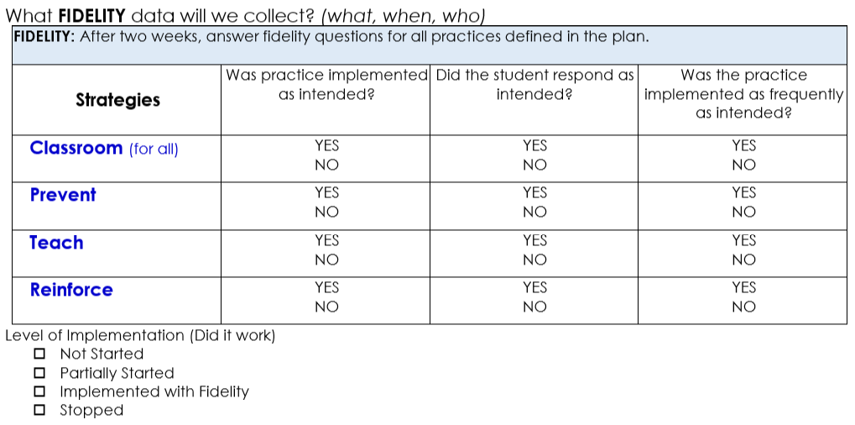

Slide 41
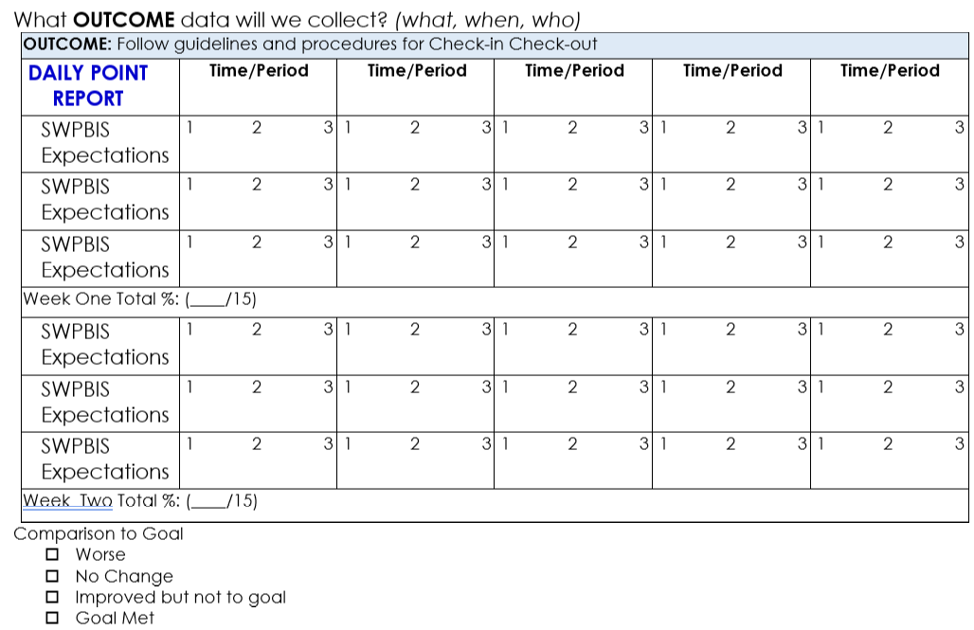

Slide 42
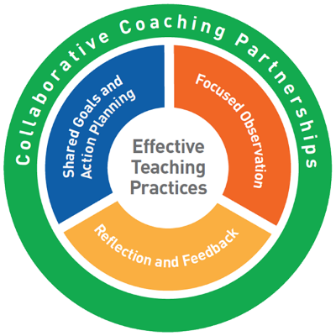
Activity #2 Page 5
PRACTICE-BASED COACHING
Shared Goals &
Action Planning
Focused
Observation
Reflection &
Feedback

Slide 43
Reflective Coaching Conversation Questions
“How do you think the solution-action plan worked?” “What parts of the solution-action plan went well?” “What parts of the plan felt less effective?” “Were there any tricky parts? What were they?”
Collaborative Coaching Conversation Questions
“Have you considered this (example)?” “What do you think would be more effective?” “Others have found this to work well. Would it work for you?” “What are your next steps?” and “What do you need from me?”
REFLECTION & FEEDBACK

Slide 45
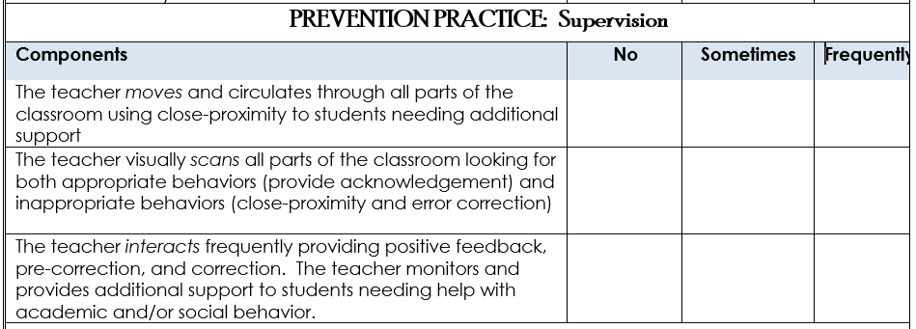

Slide 46
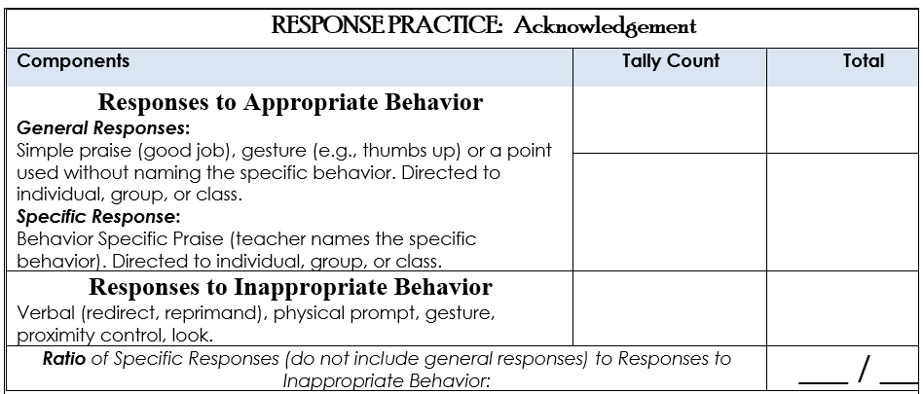

Slide 47
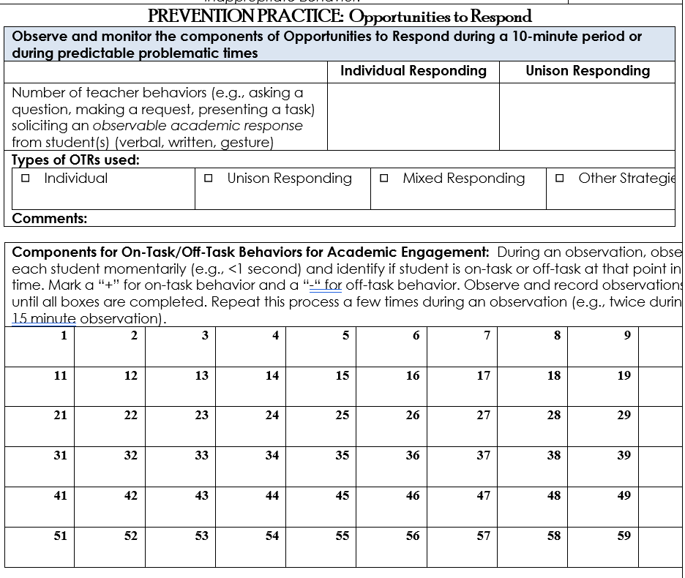

Slide 49
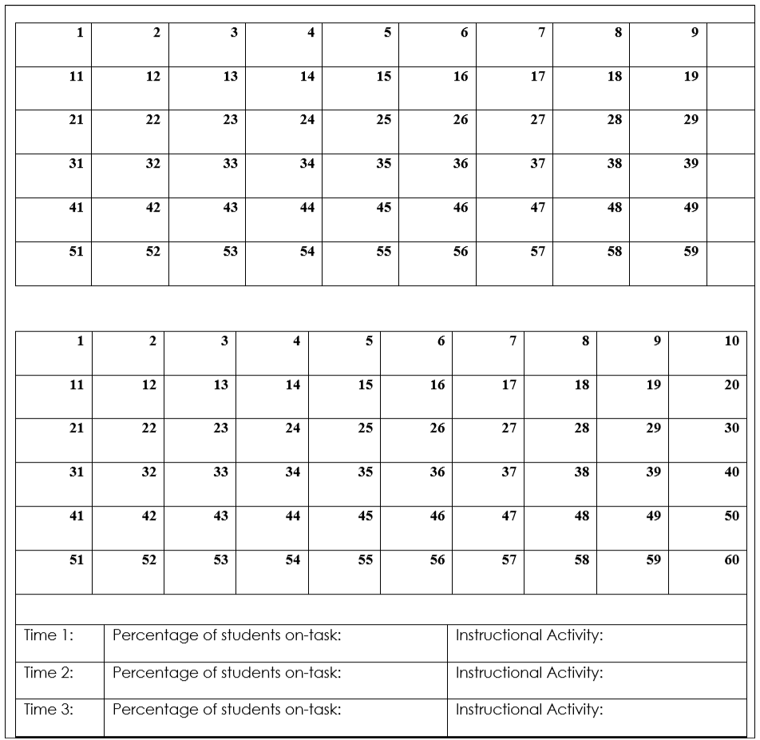

Slide 50
Student/Classroom Observation and Analysis

Slide 51
Student/Classroom Observation and Analysis

Slide 52
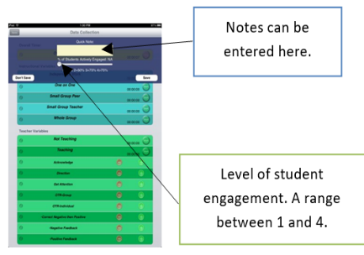
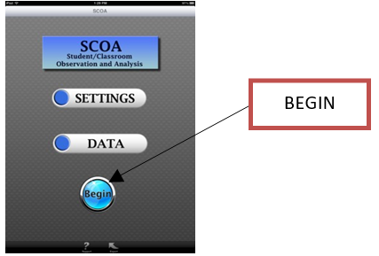
Student/Classroom Observation and Analysis

Slide 53
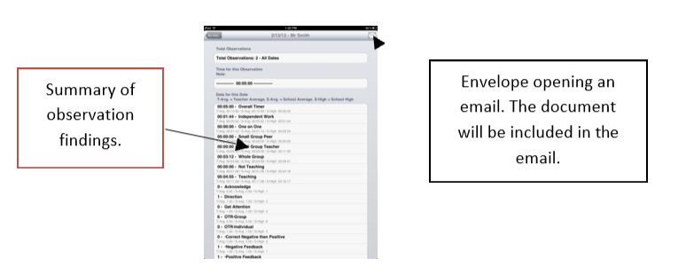
Student/Classroom Observation and Analysis

Slide 54
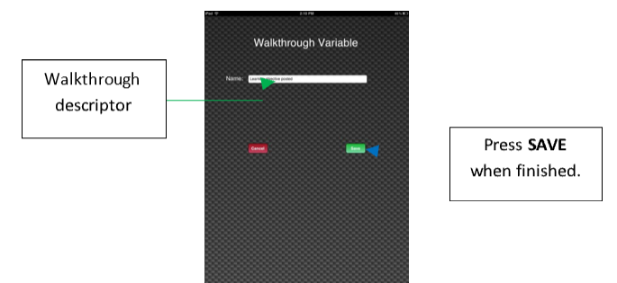
Student/Classroom Observation and Analysis

Slide 55
What Positive Classroom Behavior Supports will you put in place the first day of school?
What individualized PCBS will you practice and build fluency next year?
PCBS Practices: | Next Steps:
Foundations
Prevention Practices
Response Practices
Individualized

Slide 56
Behavioral Expectations
Respectful | Team Player | Amazing
Raffle
Winner
Raffle
Winner
Raffle
Winner

